Slide 1
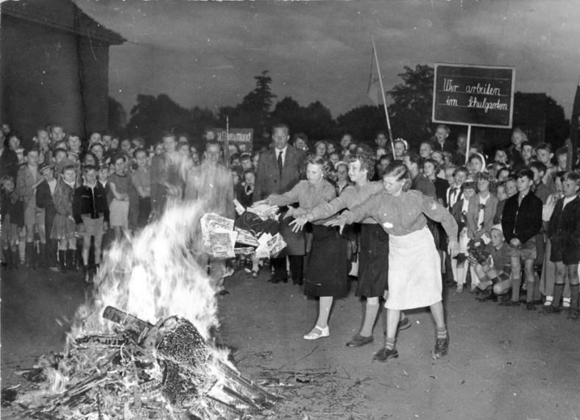
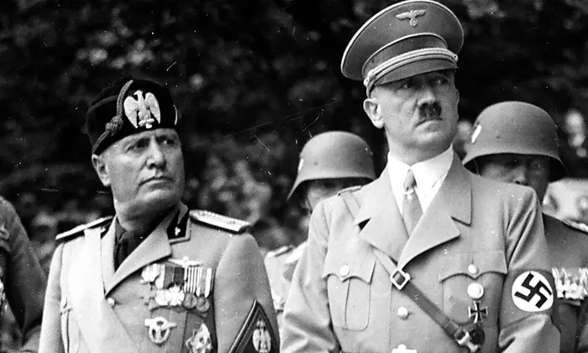
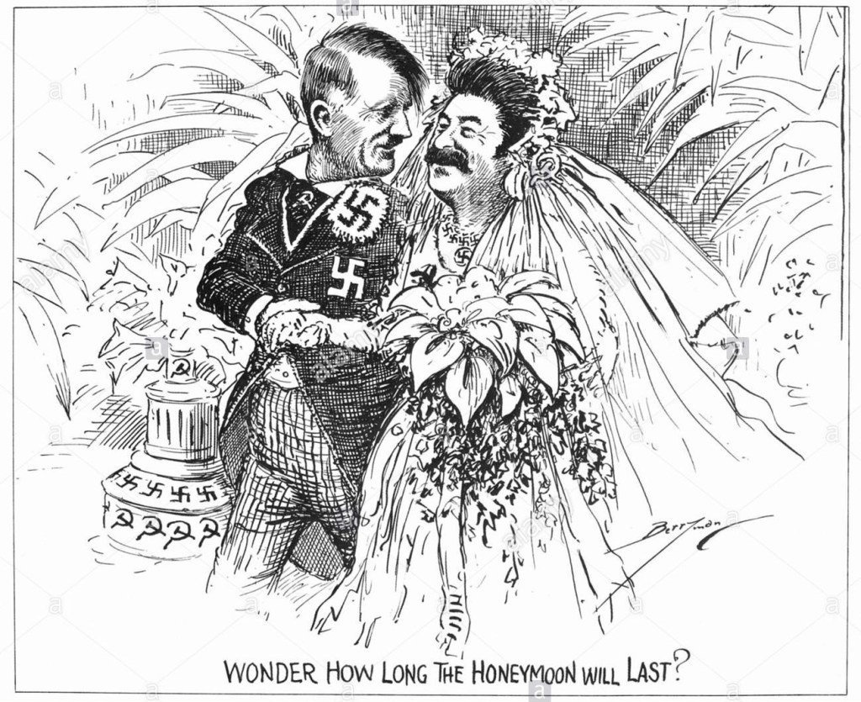
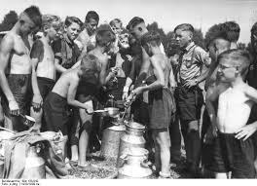
Warm up: Analyze the pictures below. What do they tell you about pre-WWII ?

Slide 2
The Nazi-Soviet Pact Game
You are Stalin’s advisers:
Background information
In 1917, there was a Communist revolution which overthrew the capitalist system in Russia. You hate capitalism and dislike capitalist countries like Britain, France and America.
They all tried to destroy your revolution, sending money and weapons to the ‘White troops’ who fought against you. It took you three years to defeat their ‘White’ army. You have never forgotten this.
The revolution and the war almost ruined Russia and left you very weak. Your ‘Five Year Plans’ to improve industrialization are slowly making Russia stronger, but it is a slow process, and Russia is still weak.
At first, the Communist revolutionaries tried to cause revolution all over the world, but after a series of failures, Stalin introduced a new policy of ‘Communism in one country’. His idea is to make Russia a strong world power first, then spread the revolution.
Your two BASIC foreign policies are, therefore:
a. PEACE - so Russia can continue to grow strong (and also so Stalin can stay in power).
b. A BUFFER ZONE of countries in between you and your enemies - especially Finland and Poland.
You consider your main enemies to be:
• Germany (who may attack by land) and
• Britain (who may attack by sea).
Until Hitler’s takeover of power in 1933, you have DONE NOTHING.

Slide 3
Your foreign policy options are:
a. Go to war with Germany
b. Offer to make an alliance with Britain
c. Join the League of Nations
d. Do nothing
e. Leave the League of Nations
f. Offer to make an alliance with Germany
Go to war with Britain
You may pick a letter twice, if the first time was incorrect.

Slide 4
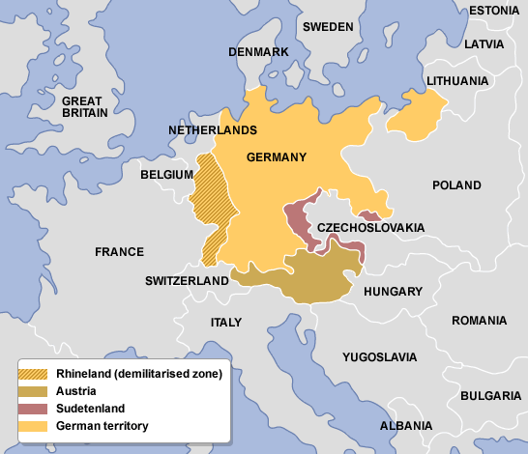
Hitler defies Treaty of Versailles re-institutes military draft reoccupation of Rhineland Anschluss- union of Germany and Austria
Munich Agreement 1938 Germany, France, GB, & Italy permit Germany
to annex part of Czech
1939 – Stalin/Hitler nonaggression pact
USSR time to build military
Germany invades Poland
1941 – falls apart when USSR is invaded by Germany

Slide 5
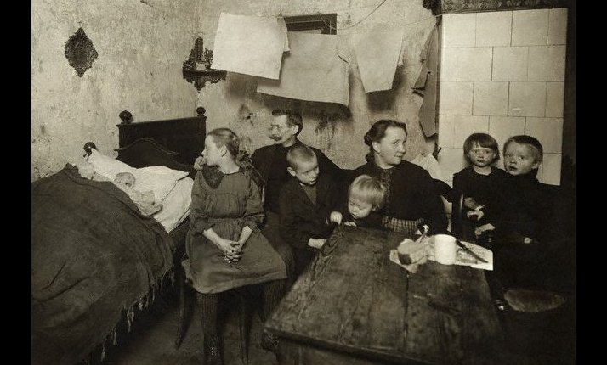
Germany in the European Theater Economic repercussions of WWI
Weimar Republic - SCAPEGOAT: presidential democracy 1919-1933 inflation and Great Depression
reparations owed (Treaty of Versailles) re-establish border w/ USSR – POLAND Adolf Hitler rises w/ Nazi totalitarianism Führer (leader) Mein Kampf (My Struggle) 1923-24 order of humans – Germanic/Aryan as master race → Jews/Slavic(Czech, Poles, Russians) Nazism/ideology of fascism vs. communism and democracy Racial doctrines: anti-Semitism and anti-Bolshevism Lebensraum (living space) for the master race (Germans) in Russia → Russians to Siberia
A poor family in Berlin. 1918 to 1933 time of low economic growth, mass unemployment and high inflation. Contributed to the support of extremist parties in Germany.

