Slide 1
Warm up: Copy down or review definitions: 1. anti-Semitism: hostility and prejudice against Jews 2. scapegoat: a person or group who is blamed for the wrongdoings, mistakes, or faults of others

Slide 2
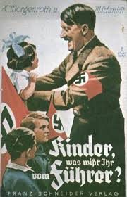
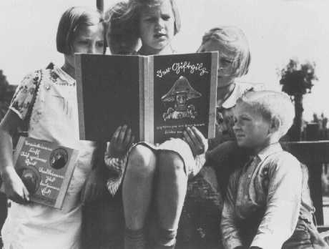
The Third Reich/Nazi State Adolf Hitler as chancellor on January 30, 1933 No guaranteed basic rights Culture, economy, education, and law controlled Propaganda Films, books, newspapers Women bear many Aryan children Gestapo (secret state police) suppressed opposition 1933 book burning – eliminate non-Aryan/German culture 25,000 university books
Kristallnacht (Night of Broken Glass) Nov. 1938 pogrom (coordinated attacks) against Jews in Germany Beginning of the Final Solution and Holocaust
German children read an anti-Jewish propaganda book titled DER GIFTPILZ ( "The Poisonous Mushroom"). The girl on the left holds a companion volume, the translated title of which is "Trust No Fox."

Slide 3
